Slide 1

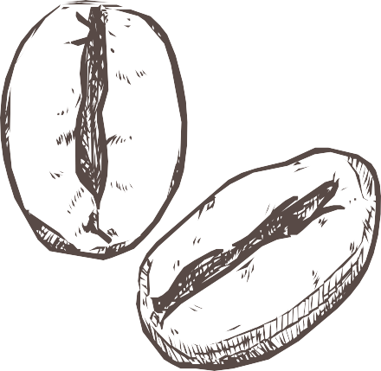



DIGITAL PORTFOLIO
FR NTED DEVEL PER P
RTF LI

Slide 2

STUDENT NAME :
REGISTER N AND NMID : DEPARTMENT:
C LLEGE :
KISH RE . L
2🖑22k1877 / asbru062🖑22k1877 BSC . C MPUTER SCIENCE
Chikkanna Govt Arts College / BHARATHIYAR UNIVERSITY

Slide 3
Problem Statement :
State tfte issue:
“Many professionals lack a visually appealing and functional online presence to sftowcase tfteir skills and projects effectively.”
“Traditional resumes fail to ftigftligftt creativity and tecftnical expertise.”

Slide 4


Project
verview :
Brief about your portfolio:
“A responsive personal portfolio website designed with a modern color theme (Yellow + Red) and Glassmorphism UI to showcase skills, projects, and contact details in an interactive manner.”

Slide 5

End Users :
List who benefits:
Recruiters Clients
Companies looking for designers or developers General audience interested in my work

Slide 6



Tools and Technologies :
Languages: HTML5, CSS3
Design: Glassmorphism UI, Gradient theme
ther Tools: Photoshop, CorelDRAW (for visuals and logo design)

Slide 7
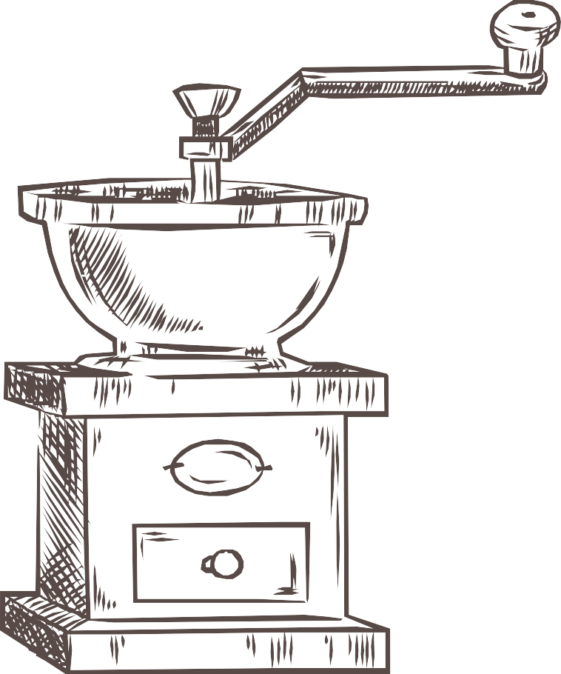
Portfolio Design and Layout :
Explain structure:
Header: Profile photo, Name, Tagline Sections: About, Skills, Projects, Contact
UI Features: Gradient background, Glassmorphism container, Hover animations, Responsive design

Slide 8

Result and Screenshot :
Add actual screenshots of your portfolio (Homepage, Projects section, Contact section)
Mention responsiveness and animations

Slide 9
Conclusion :
Summarize:
“This portfolio demonstrates both my design skills and coding expertise, providing a modern and professional online presence.”

Slide 10
GitHub Link :
Add clickable link to your GitHub repository:
Example: GitHub Repository

Slide 11

















THANK Y U
www.reallygreatsite.com

